Slide 1
Do’s And Don’ts of PPT
A Guide to Creating Effective and Engaging slides

Slide 2
PowerPoint Presentation
A PowerPoint presentation is a visual tool made with Microsoft PowerPoint, a software program in the Microsoft Office family. It’s used to show information on slides, helping speakers present their ideas clearly and effectively.
It is mainly used in Education, Business, Organization, Marketing, Conferences
What it is?

Slide 3

Do’s
20XX
Colors
Bullets
Concise and to the point
Dark letters on light background
Use Bullet Points
Keep text concise and to the point
Order
Visuals
No of Bullet Points
Organize your slides in order
Make it visually Interesting
Limit the Bullet to <6 in a Slide

Slide 4
Do’s
20XX
Summation slide
Provide valid examples
Summarize your topic at the end
Give examples if needed
Technical errors
Backup your ppt
Test your equipment before present
Keep a copy of your ppt as backup

Slide 5

Don’ts
20XX
Overloaded Text
Style and Size
Low resolution Images
Avoid too much text in one slide
Avoid multiple fonts size, styles
Avoid irrelevant images
Distracting Background
Inconsistent format
Uppercase letters
Don’t use distracting background
Formatting matters
Don’t use all uppercase letters

Slide 6
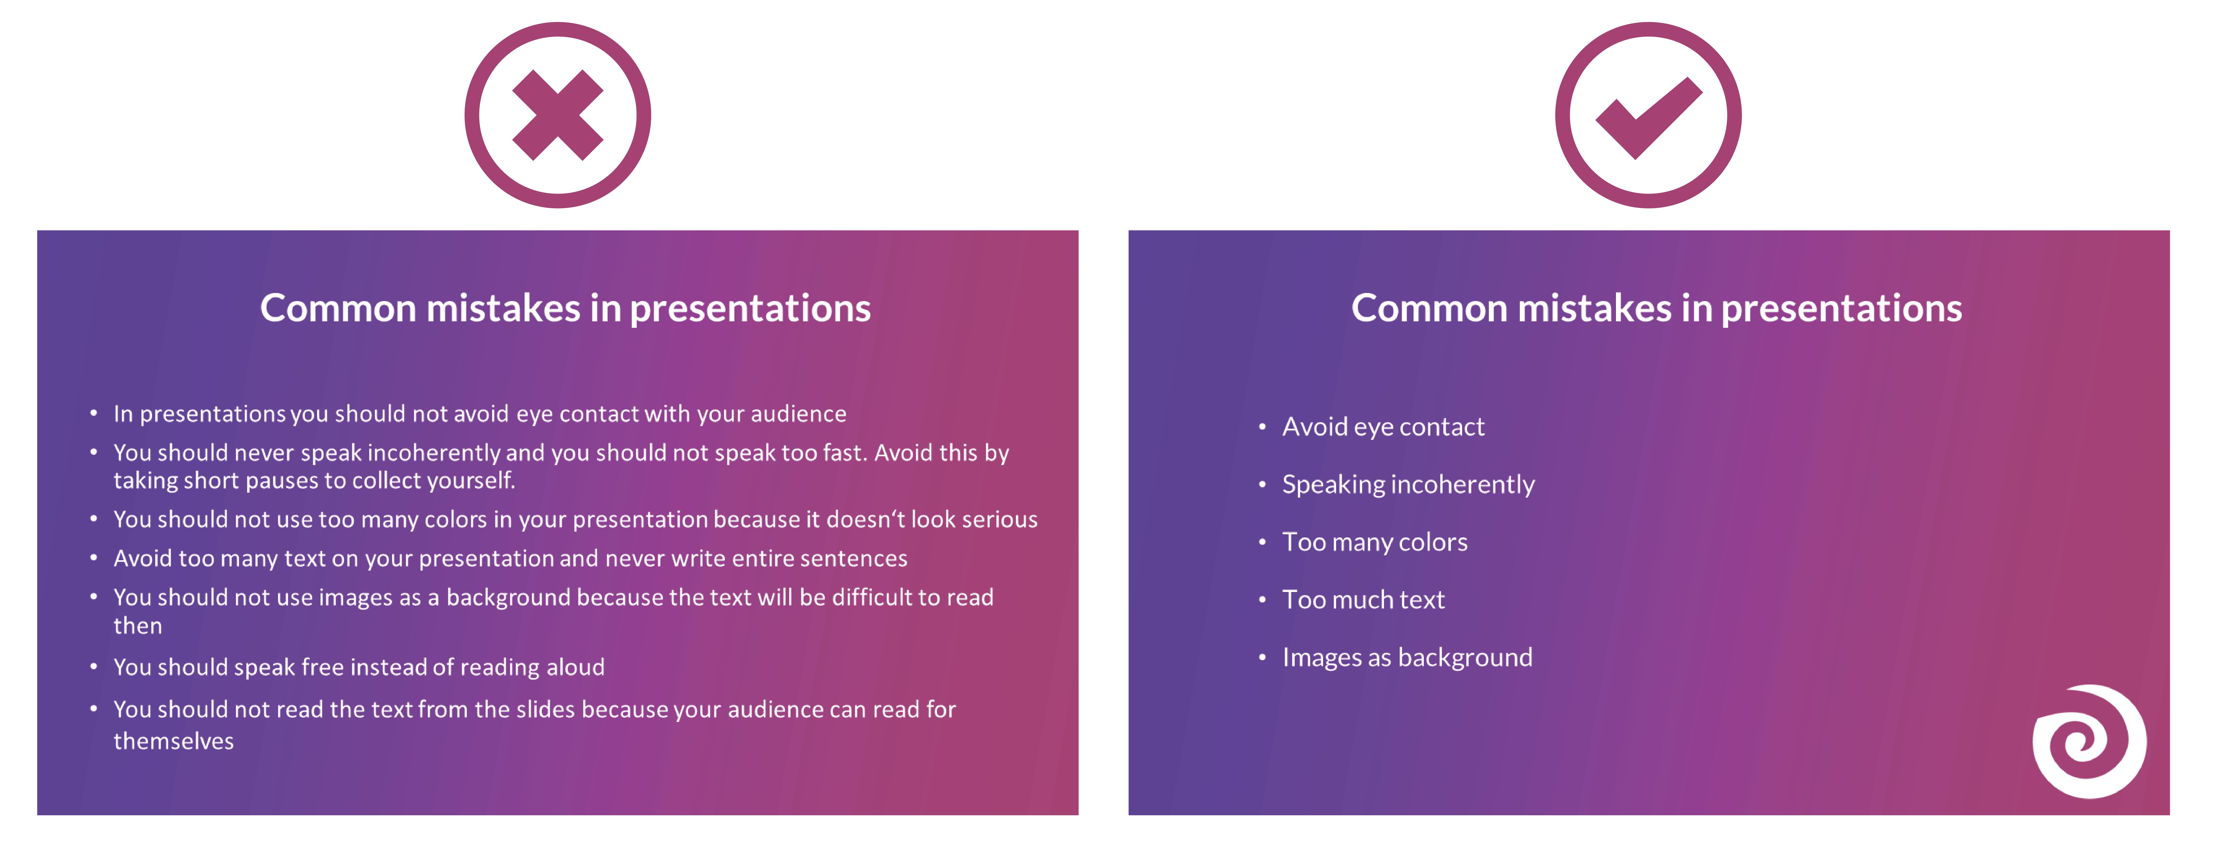
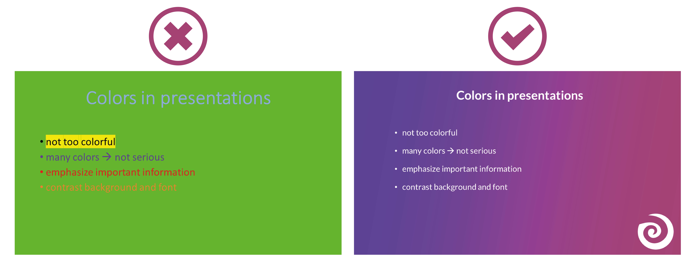
20XX

Slide 7
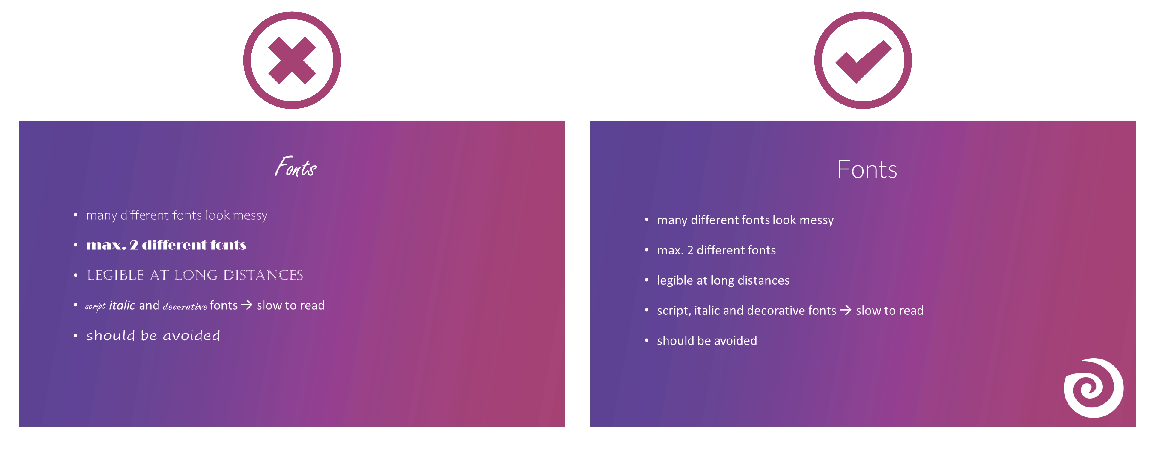
20XX

Slide 8
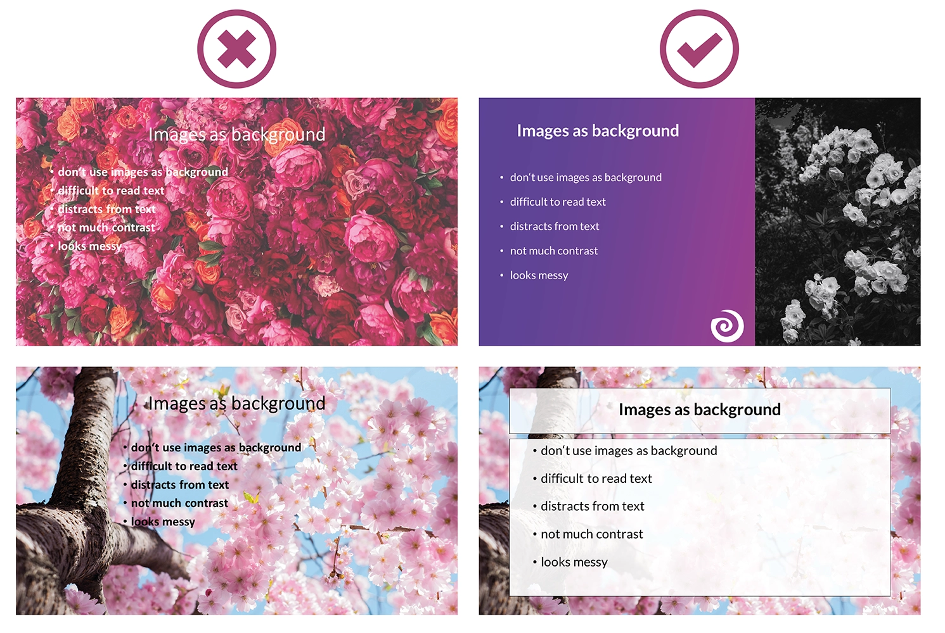
20XX

Slide 9
Subject: Guidelines for do’s and don’ts in Power Point Presentation
Hi Taks,
I hope you're doing well! As you're getting ready for your presentation, I wanted to share some simple tips to help you design effective PowerPoint slides.
Firstly, keep it simple. Each slide should focus on just one main point to avoid overwhelming your audience. Try to use clear and concise language to get your message across. Secondly, visuals can really enhance your presentation. Including relevant images and charts can help to clarify complex ideas and keep your audience engaged.
Consistency is key. Make sure all your slides have a uniform design theme, using the same fonts and colors throughout. This will give your presentation a polished and professional look. Practice makes perfect. Take some time to rehearse your presentation so you feel confident and prepared on the day. This will also help you to anticipate any questions your audience might have.
On the flip side, try to avoid overcrowding your slides with too much text or unnecessary graphics. Keeping your slides clean and uncluttered will make it easier for your audience to follow along. Similarly, stick to clear, easy-to-read fonts. Fancy fonts might look nice, but they can be difficult to read, especially from a distance.
And finally, remember that your slides are there to support your presentation, not to replace it. Avoid reading directly from your slides and instead use them as prompts to guide your talk.
I hope these tips help you to create a great presentation! Let me know if you have any questions.
Best regards,
Nune Naresh

Slide 10
THANK YOU!
Nune Naresh

